Slide 1


TODO app on top of Forgejo
Jos van den Oever

Slide 2
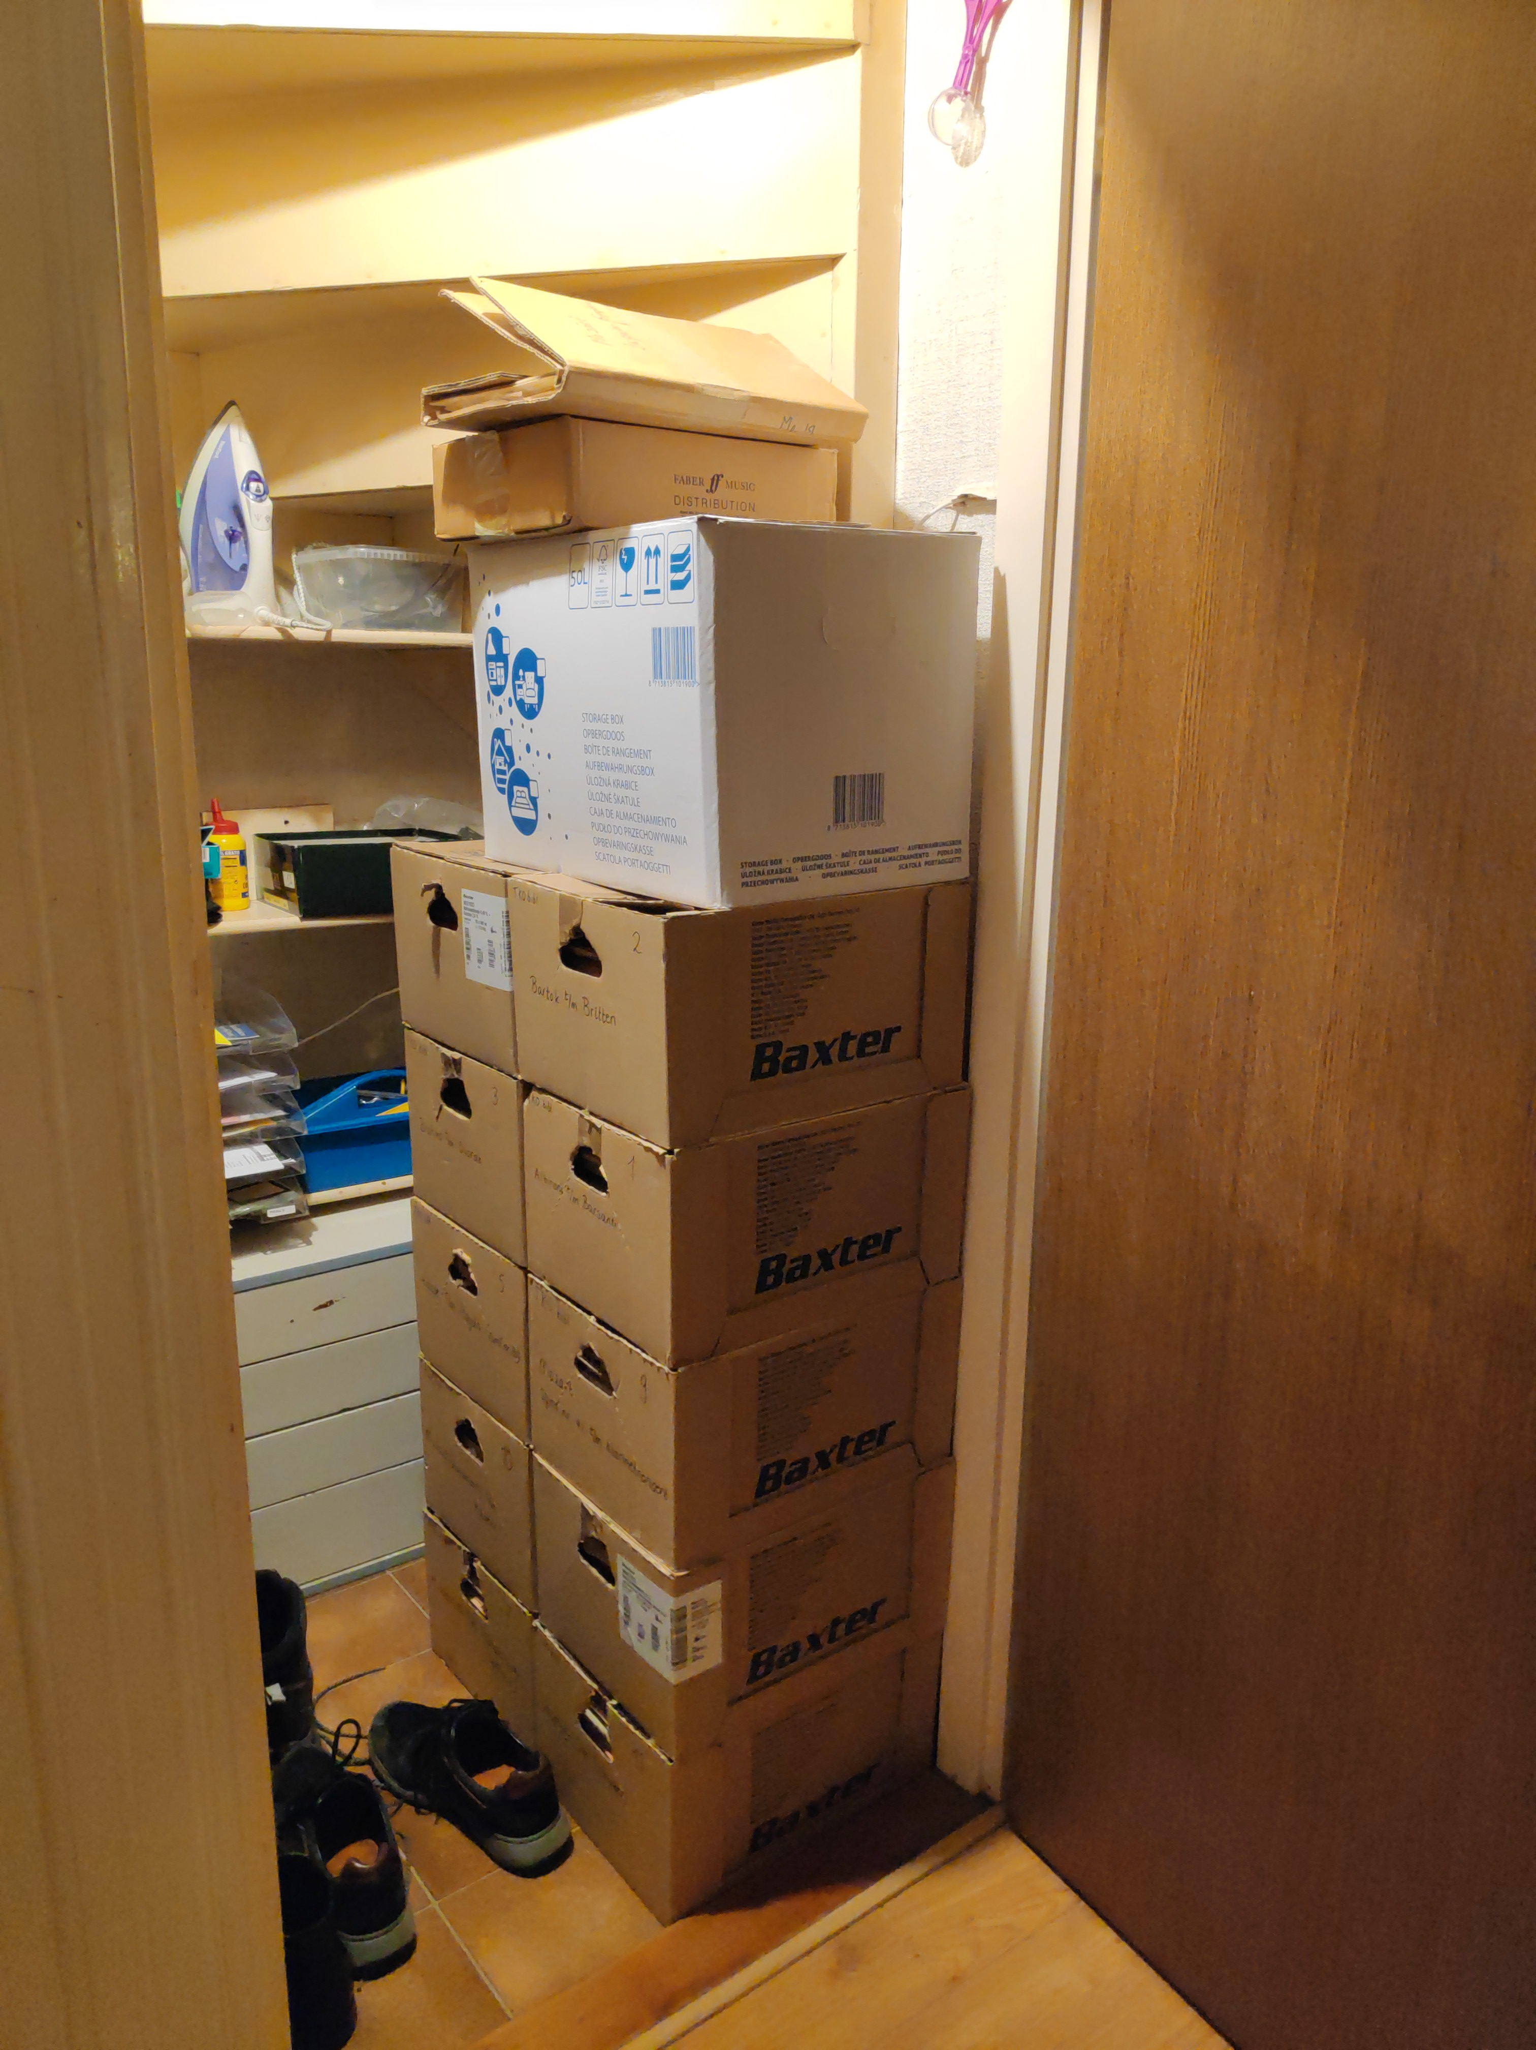
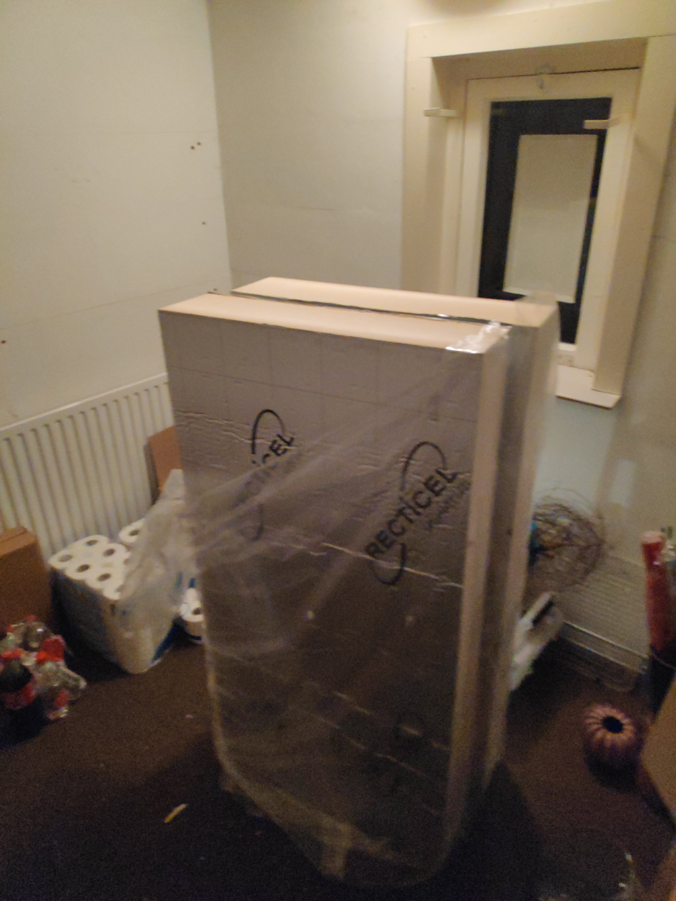
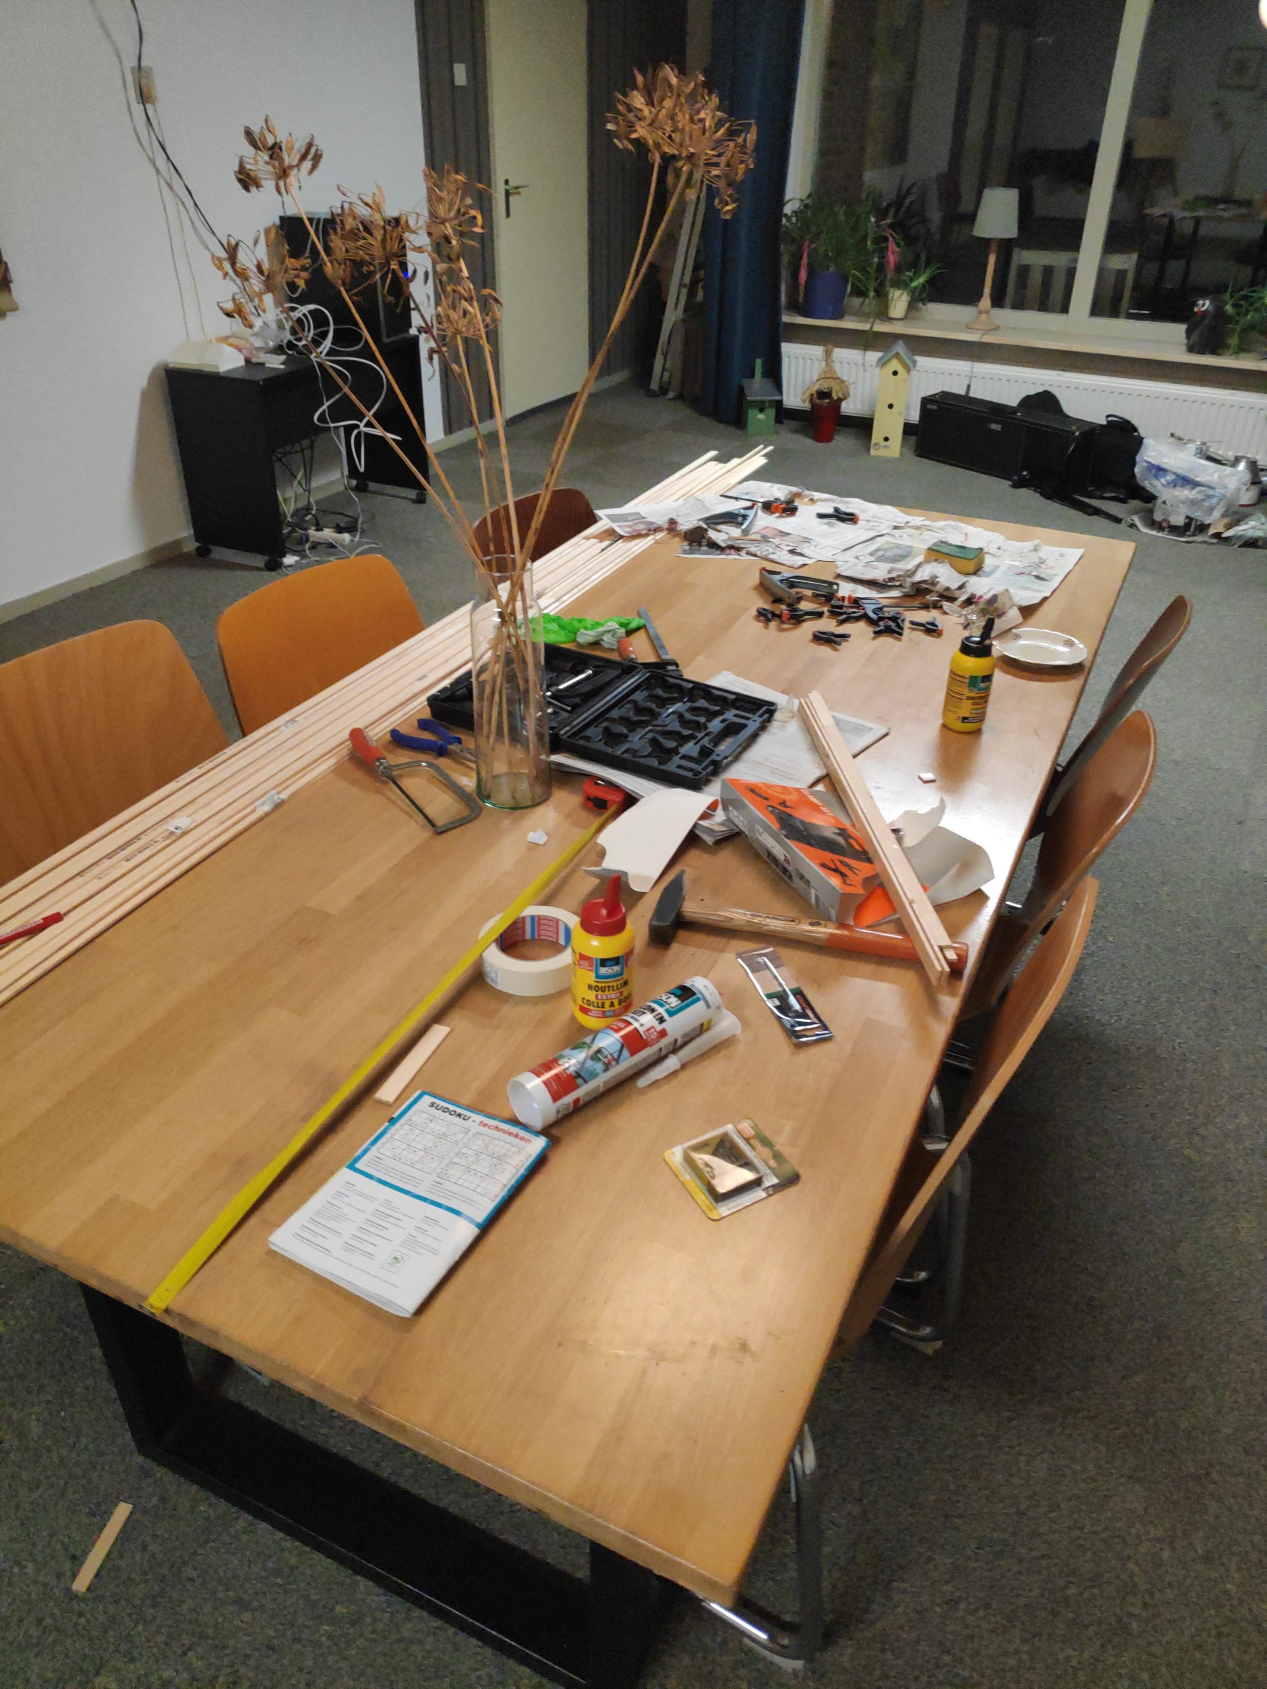
TODO apps, do they work?
☐ unpack boxes
☐ assemble window panes
☐ isolate attic
☑ fosdem talk

Slide 3
Desirable features
Notes
Collaborative
Attach pictures
Add links
Priorities
Deadline
Dependencies
Multiple devices
Nice mobile interface
Easy to use
Labels / tags
Kanban
Timeline / Change tracking
Releases dopamine
Low maintenance
Notes:
Collaborative because we should not face our issues alone.

Slide 4
Possible choices
Todo.txt
VTODO iCalender
NextCloud Tasks
OpenProject
TaskWarrior
Reinvent the wheel

Slide 5
Why not a code forge?
Most code forges have all the desired features
Talk about issues instead of tasks
And they have API support
Which code forge?

Slide 6
Which code forge?
Microsoft GitHub Closed big tech
GitLab Good, but heavy
SourceHut Complicated
Gitea / Forgejo Almost ideal

Slide 7

Stop using GitHub!
If you continue to use GitHub
you are using closed source
you agree with bad terms of service
you are part of a bad network effect
you do product placement for Microsoft
you teach people not to care about software freedom

Slide 8
What is Forgejo?
Code forge
Written in Go
Forked from Gitea
Easy to host

Slide 9
My relation with Forgejo
Just a user and big fan
Use it at
  NLnet
  home
  Codeberg

Slide 10

Non-profit for collaborating on FOSS
Runs on Forgejo
Hosts Forgejo code
Member organization
Easy to import from other forges

Slide 11
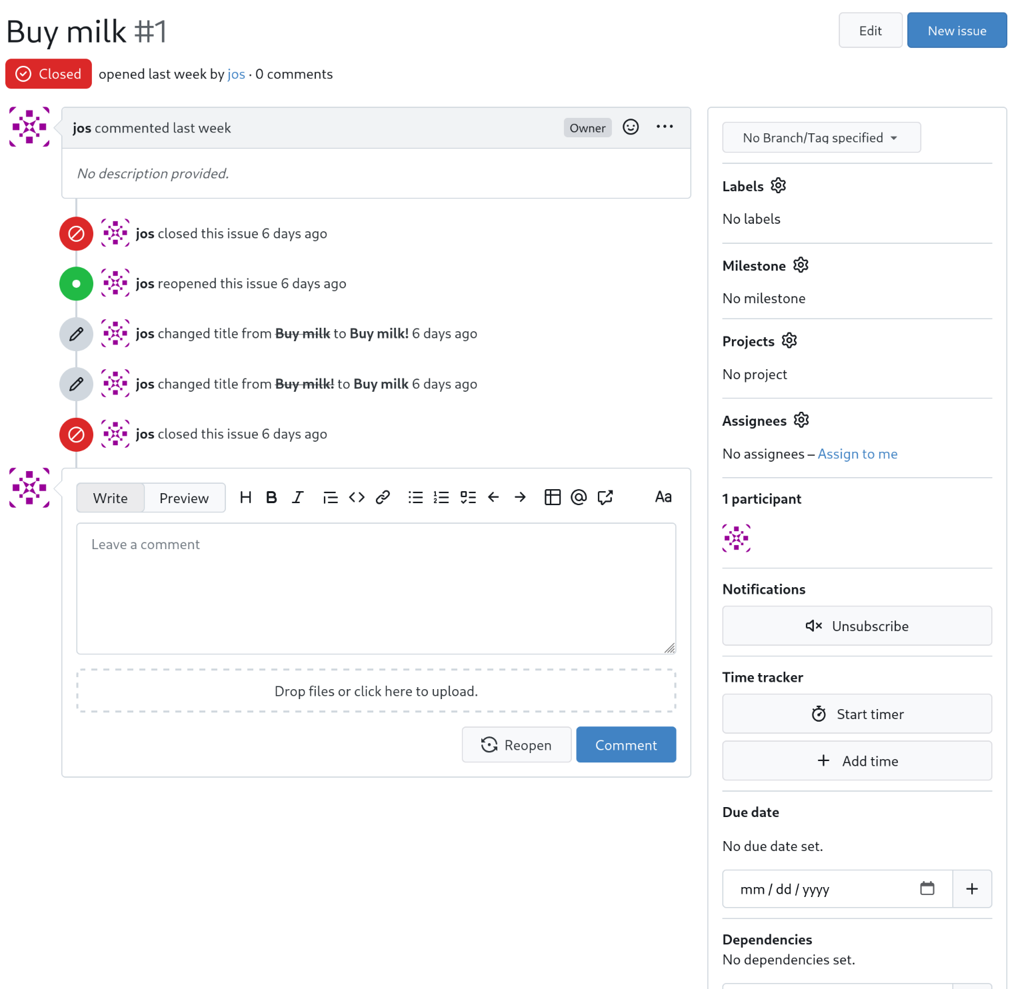
Notes
Collaborative
Attach pictures
Add links
Priorities
Deadline
Dependencies
Multiple devices
Nice mobile interface
Easy to use
Labels / tags
Kanban
Timeline / Change tracking
Notes:
Collaborative because we should not face our issues alone.

Slide 12
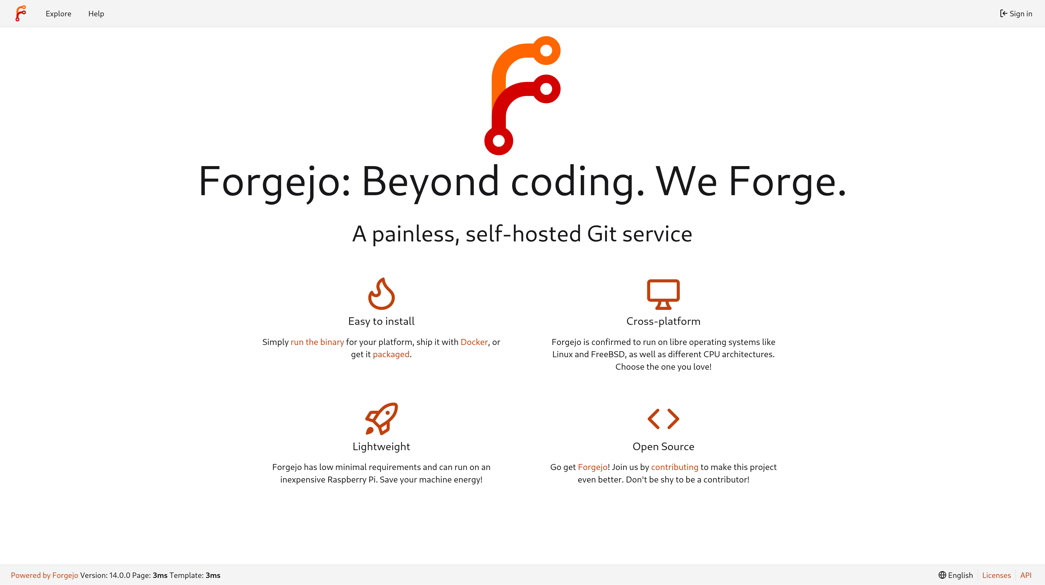


Slide 13
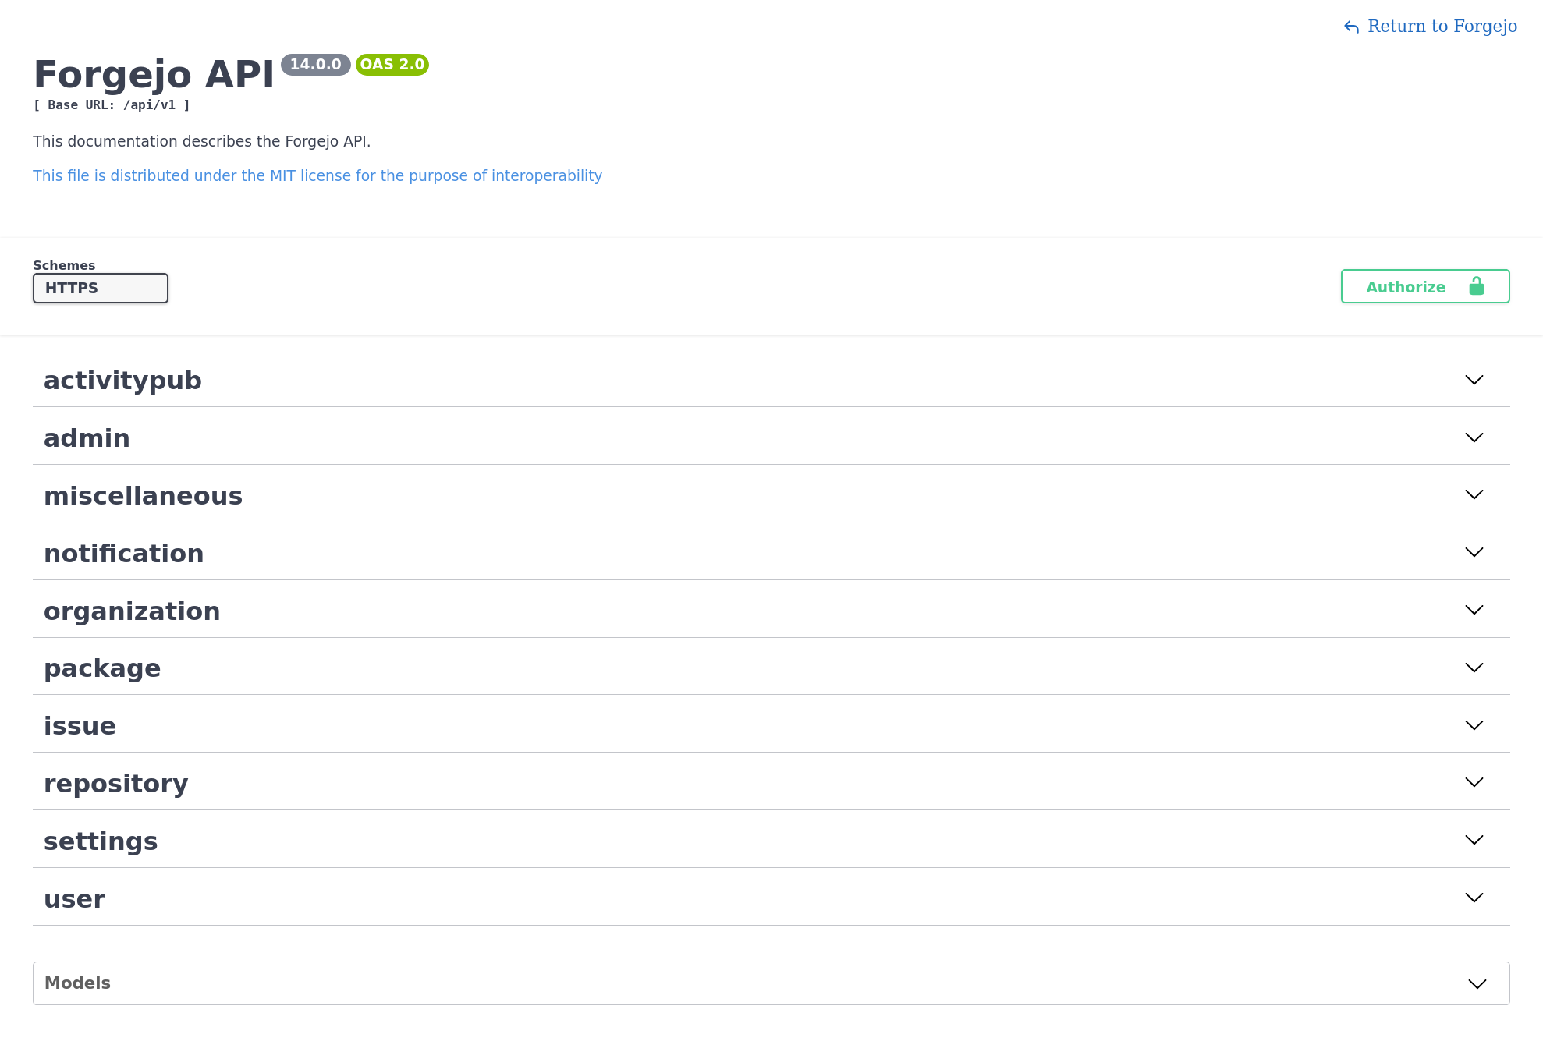

Slide 14

Let’s code a TODO PWA
https://codeberg.org/vandenoever/fosdem2026todo
https://fosdem2026todo.vandenoever.info
HTML, JavaScript, JSON, and SVG
Serve from a static web server
Install on Android or iOS without app store

Slide 15
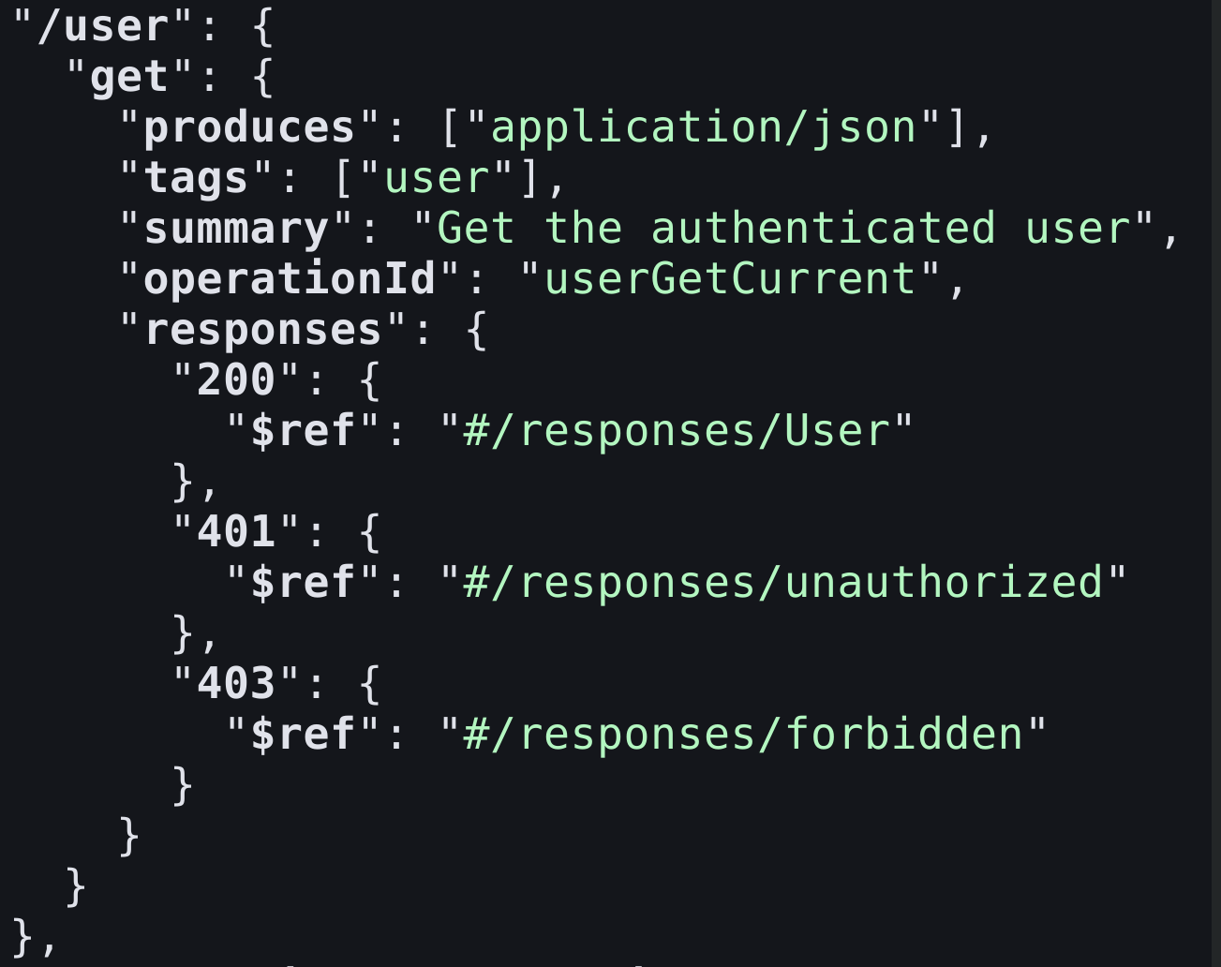

Slide 16
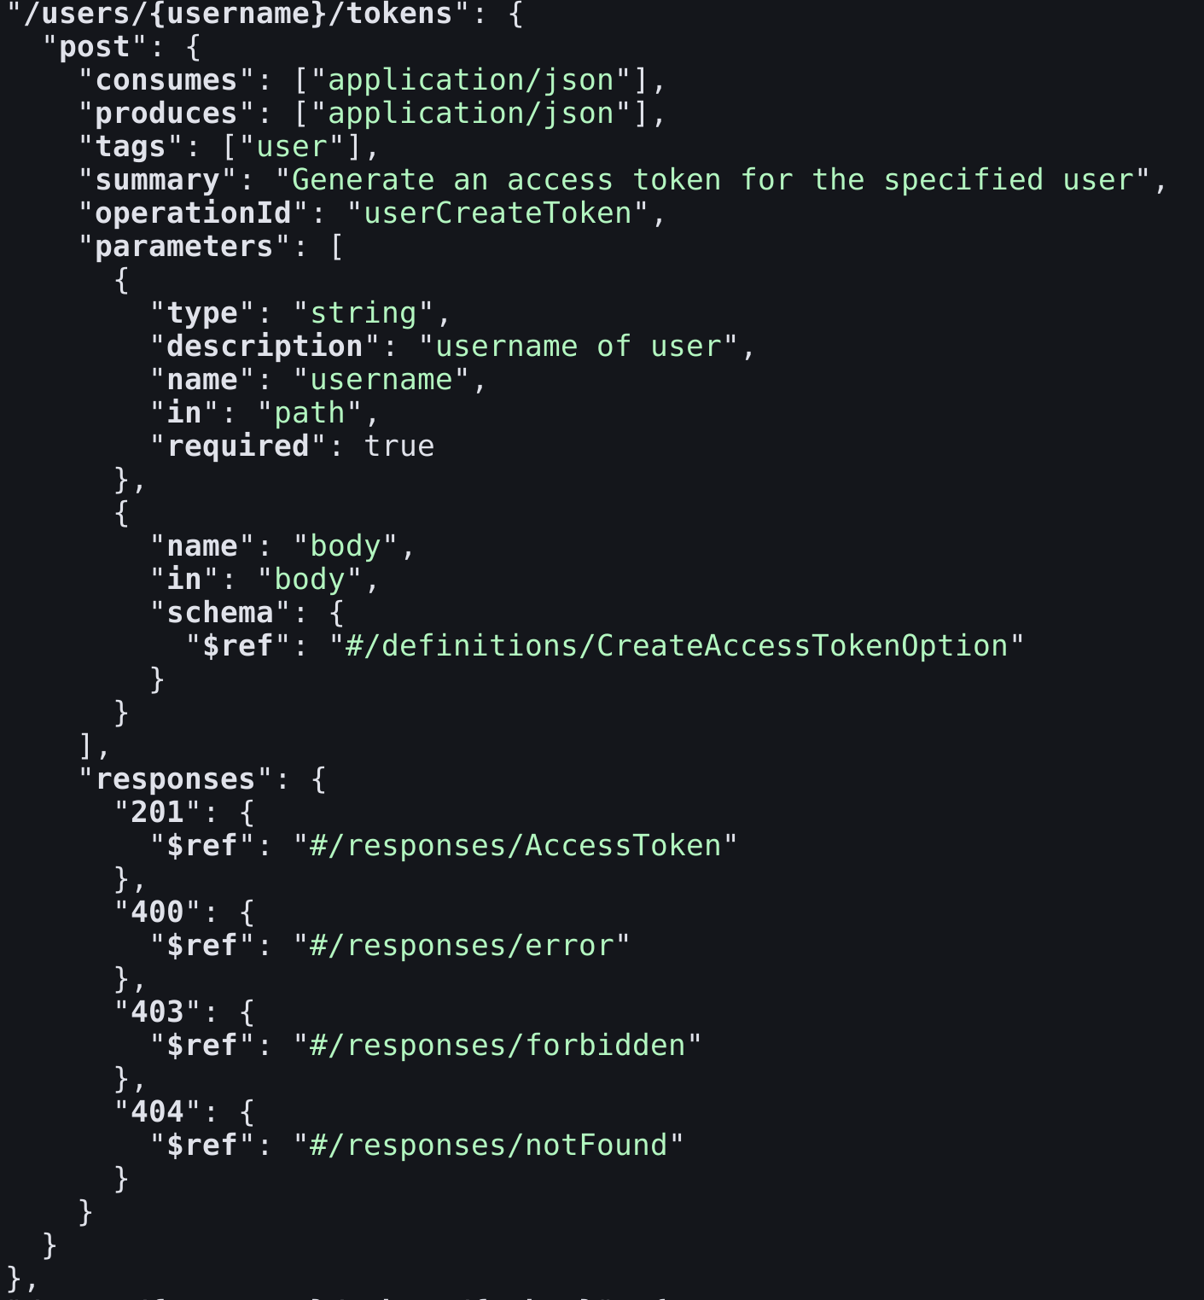

Slide 17
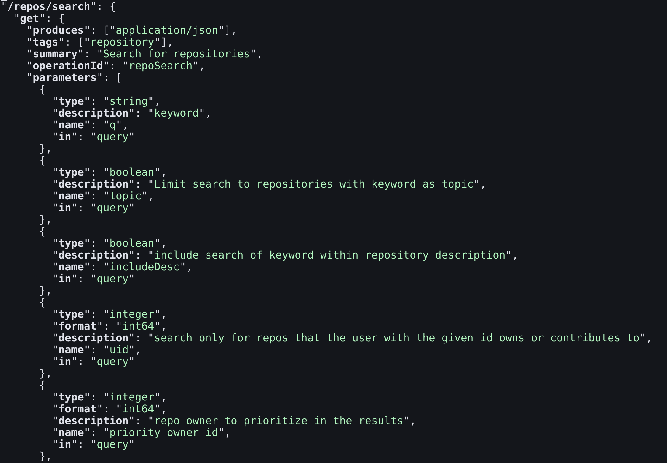

Slide 18


Generate frontend API
Reads the API JSON
Writes Typescript in a chosen flavor
  React/Svelte/Vue…
  Fetch/Axios/…
  Tanstack Queries

Slide 19
Tanstack Queries
Cache queries
Invalidate queries
Global access to query results

Slide 20
Create application
npm create vuetify@latest
npm run dev
wget https://codeberg.org/swagger.v1.json
npx orval --config orval.config.ts
30kLoC swagger file → 60kLoC ts file

Slide 21
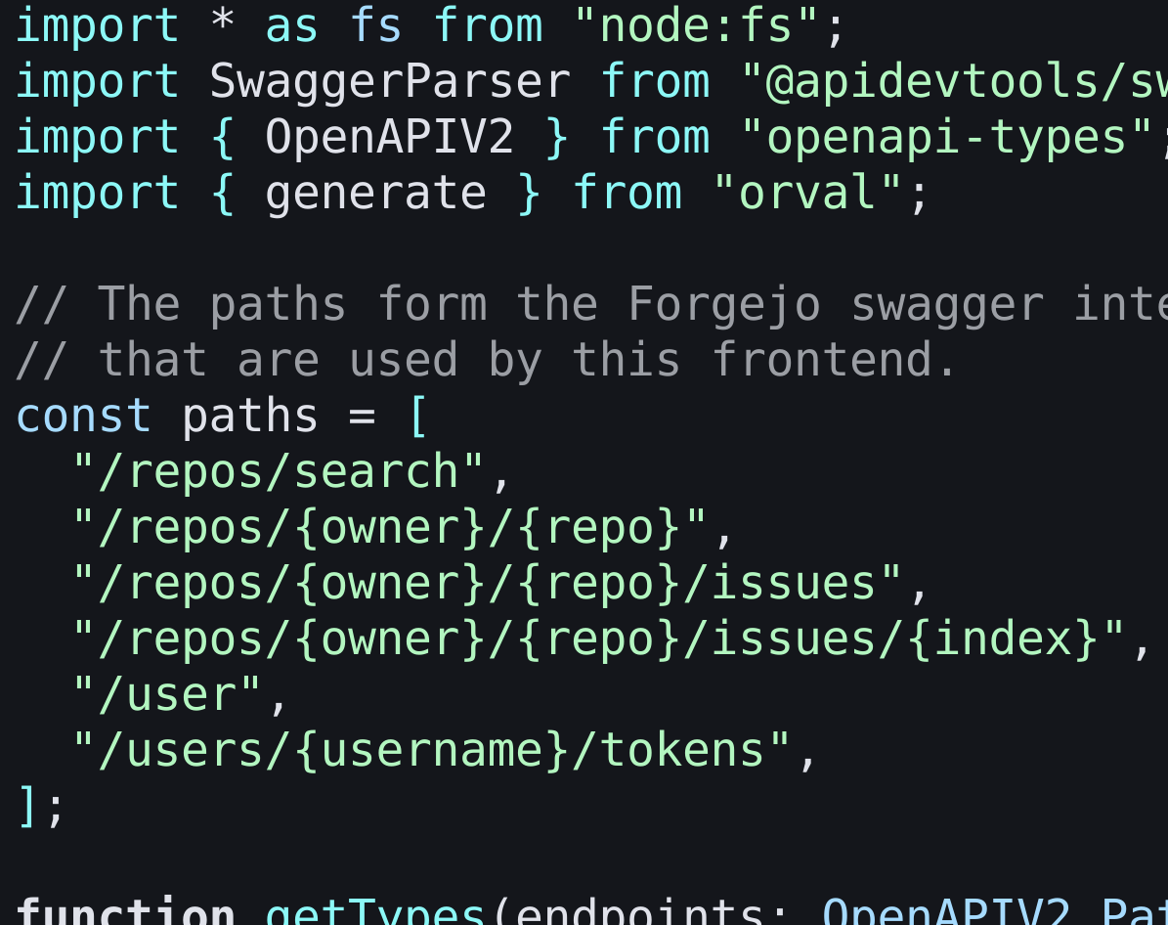
Reduce the generated code
filterForgejoApi.ts
List the needed endpoint
Creates smaller API file with those endpoints and types
30kLoC → 2kLoC

Slide 22
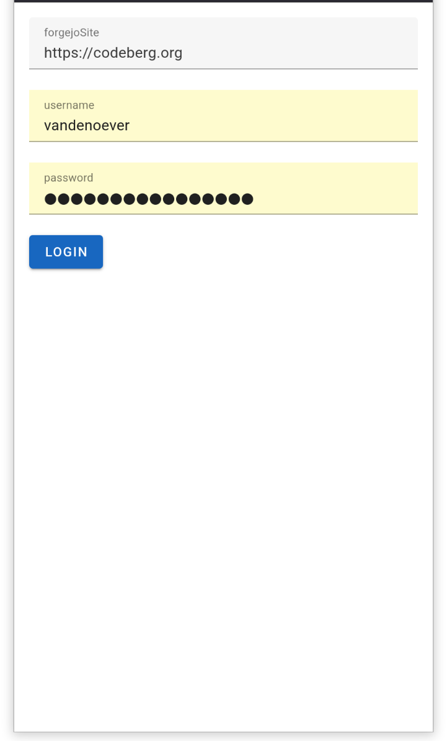
Login screen
Provide the full url of the server
Password goes directly to the Forgejo server

Slide 23
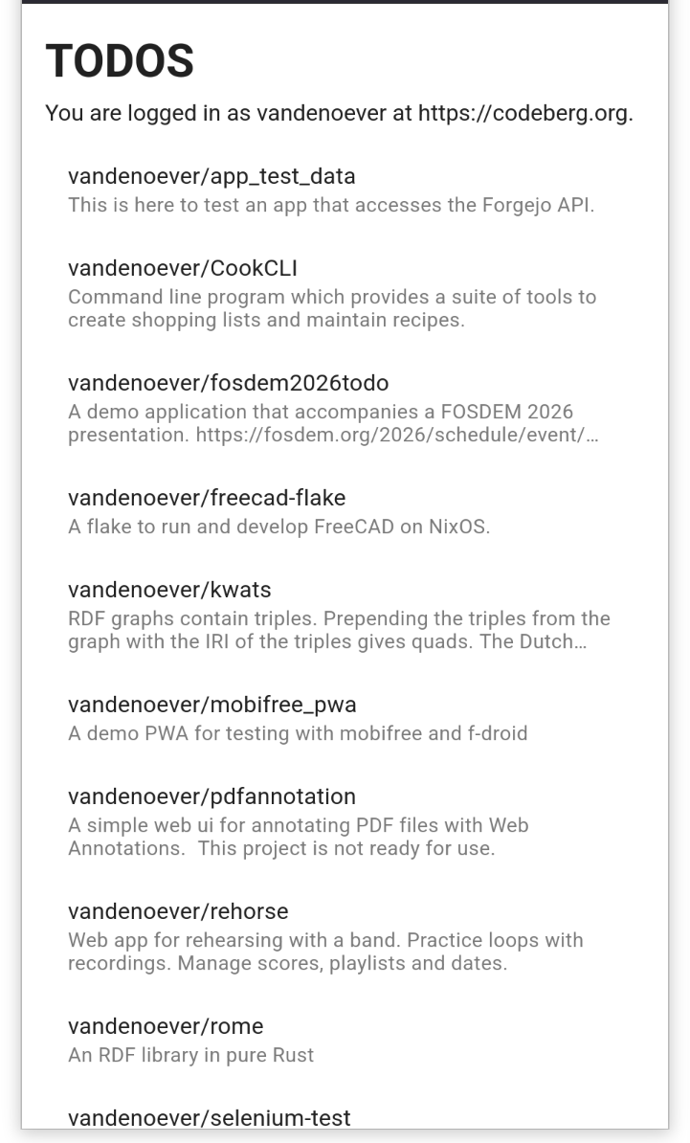
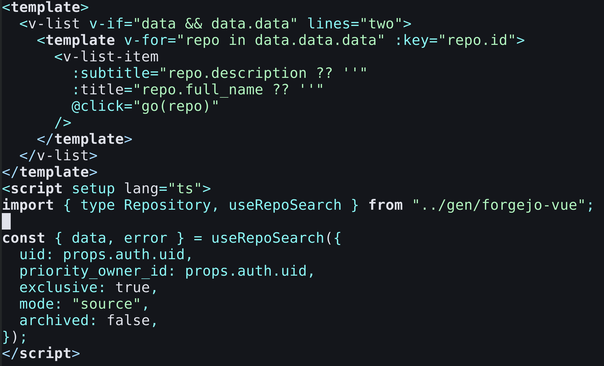
Repository screen

Slide 24
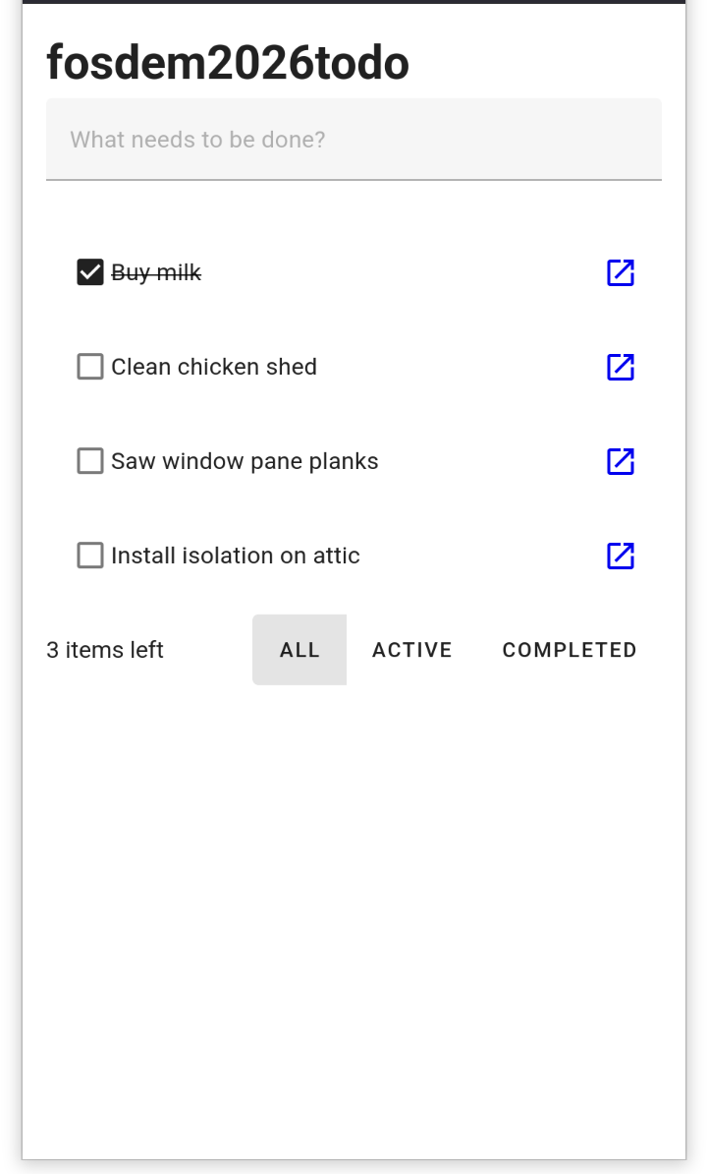
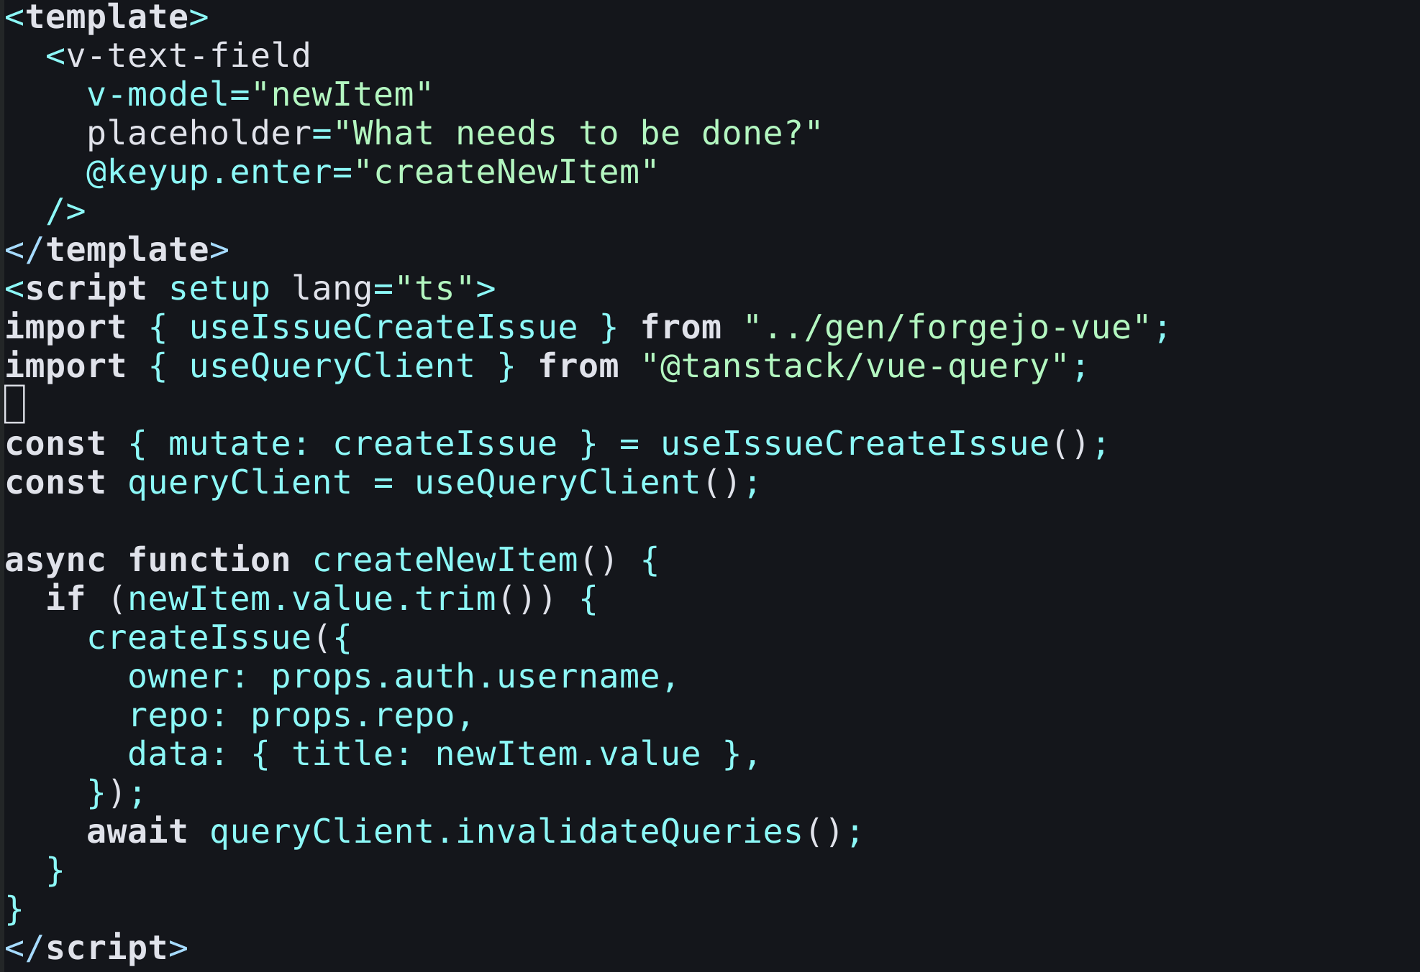
Todo screen

Slide 25
Observations
Enable CORS on Forgejo
Direct login only works since a few releases
Comment preview in Forgejo is done on the server
API changes every 6 months: check the correct version
This is just CRUD, not local-first software,
The user must be online

Slide 26
Conclusions
Forgejo
is fantastic
is a good backend for a TODO app

Slide 27
Will I continue on this app?
I am going to work on my issues

